Slide 1
FRAUD DETECTION SYSTEM
DATA ANALYSIS
DONE BY
JISSY JAYAPRAKASH

Slide 2
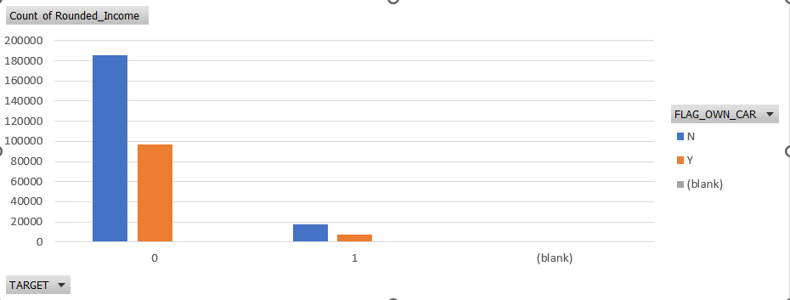
Detecting the Fraud activity with the people who own car compared with their total income
Count of Rounded_Income | Column Labels
Row Labels | N | Y | (blank) | Grand Total
0 | 185675 | 97011 |  | 282686
1 | 17249 | 7576 |  | 24825
(blank)
Grand Total | 202924 | 104587 |  | 307511

Slide 3
From the above table as well as from the graph its clear that people with low income that is below 20000 total income are tend to be fraud.
The same category with not owing a car are tend to be more fraud.
Detecting the Fraud activity with the people who own car compared with their total income

Slide 4
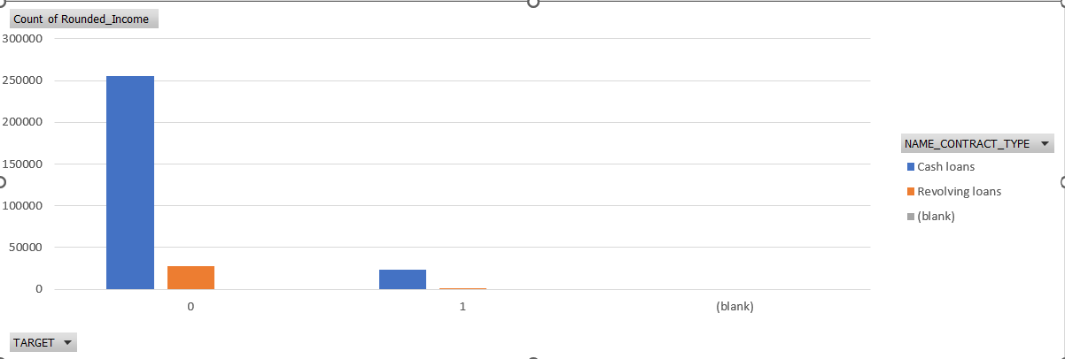
Detecting the Fraud activity with the person contract type compared with their total income
Count of Rounded_Income | Column Labels
Row Labels | Cash loans | Revolving loans | (blank) | Grand Total
0 | 255011 | 27675 |  | 282686
1 | 23221 | 1604 |  | 24825
(blank)
Grand Total | 278232 | 29279 |  | 307511

Slide 5
From the above table as well as from the graph its clear that people with low income that is below 30000 total income are tend to be fraud.
The same category with taking contract type of cash loans are tend to be more fraud compared to people who is taking revolving loans.
Detecting the Fraud activity with the person contract type compared with their total income

Slide 6
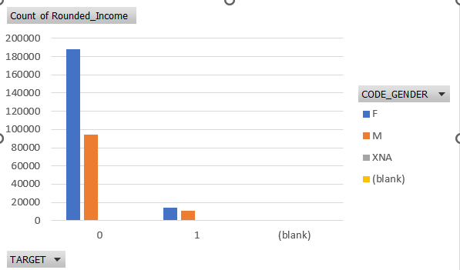
Detecting the Fraud activity with the code gender compared with their total income
Count of Rounded_Income | Column Labels
Row Labels | F | M | XNA | (blank) | Grand Total
0 | 188278 | 94404 | 4 |  | 282686
1 | 14170 | 10655 |  |  | 24825
(blank)
Grand Total | 202448 | 105059 | 4 |  | 307511

Slide 7
Detecting the Fraud activity with the code gender compared with their total income
From the above table as well as from the graph its clear that people with low income that is below 20000 total income are tend to be fraud.
In this category, number of male who is doing fraud activity is less compared to female and there is a difference of only 4000.

Slide 8
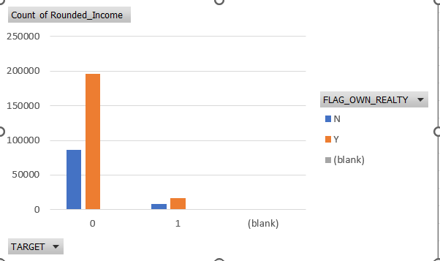
Detecting the Fraud activity with the person who own realty compared with their total income
Count of Rounded_Income | Column Labels
Row Labels | N | Y | (blank) | Grand Total
0 | 86357 | 196329 |  | 282686
1 | 7842 | 16983 |  | 24825
(blank)
Grand Total | 94199 | 213312 |  | 307511

Slide 9
Detecting the Fraud activity with the person who own realty compared with their total income
From the above table as well as from the graph its clear that people with low income that is below 20000 total income are tend to be fraud.
In this category, the people with realty is relatively high for doing fraud activities when compared to the people with no realty .

